Slide 1

Web Presence Project
Crafting & Compelling Website Analysis, Audit and Recommendations
Presentation by :
Bala Muralidhar Reddy

Slide 2
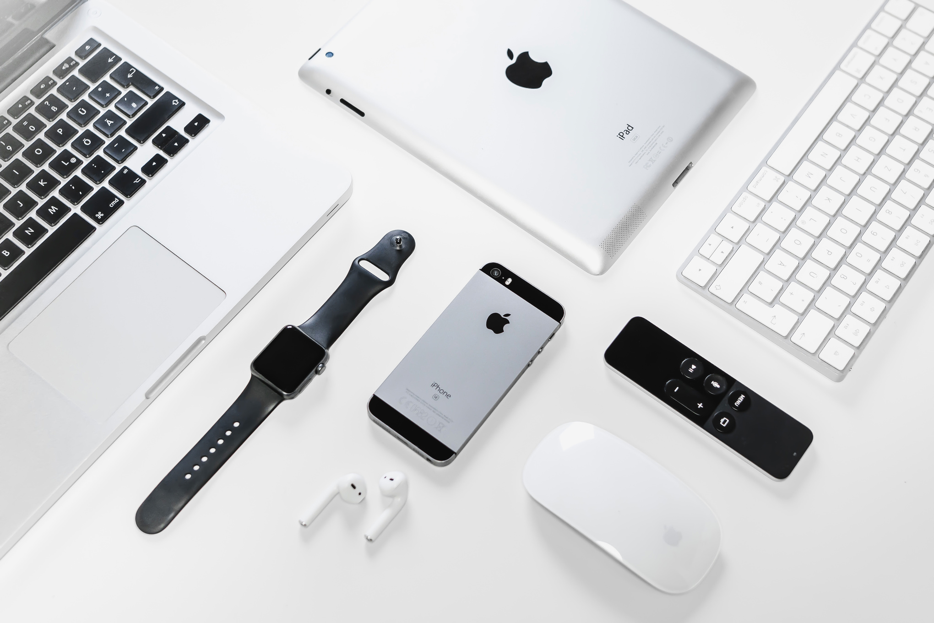
Company Selection
I selected the company “APPLE” for this Web Presence Project
About Company
Apple Inc. is a multinational technology company known for its innovative consumer electronics, software, and services.
Founded in 1976, Apple has revolutionized industries with products like the iPhone, iPad, Mac, and Apple Watch.

Slide 3



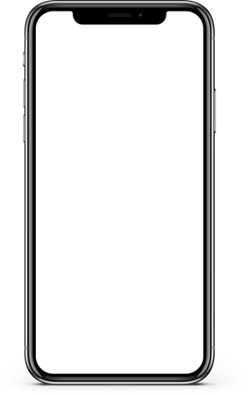



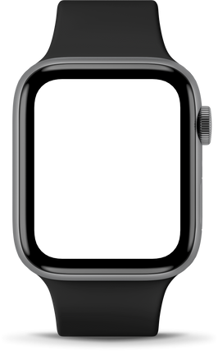
Product and Services

Slide 4
01
iPhone: A smartphone known for its sleek design, powerful performance, and innovative features like Face ID, A-series chips, and the App Store.
Product Descriptions
02
iPad: A tablet device designed for productivity, entertainment, and creativity, offering a large display, multitasking capabilities, and access to a wide range of apps.
03
Mac: A line of personal computers known for their performance, reliability, and macOS operating system, which is designed for professionals and creative individuals.
04
Apple Watch: A smartwatch that combines fitness tracking, notifications, and app functionality, providing a personalized health and wellness experience.

Slide 5
01
Apple Music: A streaming music service that offers millions of songs, curated playlists, and personalized recommendations
Service Descriptions
02
Apple TV+: A video streaming service that offers original TV shows and movies, exclusive content, and family-friendly programming.
03
Apple Arcade: A gaming subscription service that provides access to a curated collection of high-quality games, without in-app purchases or ads.
04
Apple Care+: An extended warranty and technical support plan that offers coverage for accidental damage and provides priority access to Apple support.

Slide 6
Website Platform Identification
Content management system: Apple.com hasn't disclosed their CMS. It is believed that they have their own CMS for the website
Analytics: Adobe Analytics
A/B testing and Personalization: Adobe Target
source: https://www.wappalyzer.com/lookup/apple.com/

Slide 7
Tools Used: Google Mobile-Friendly Test, GTmetrix
Report:
●Homepage: Mobile-friendly with some minor alignment issues.
●Services Page: Great , they mentioned all the services and they have different pages for different types of services
●Entertainment Page : Well-optimized for mobile, though text size can be increased.
●Cart Page : Responsive with a good user interface.
source: files are at https://drive.google.com/drive/folders/18IgNLuFG4_sWeNdKDYi98z-28Yjfv3LN
Responsive Design Testing

Slide 8
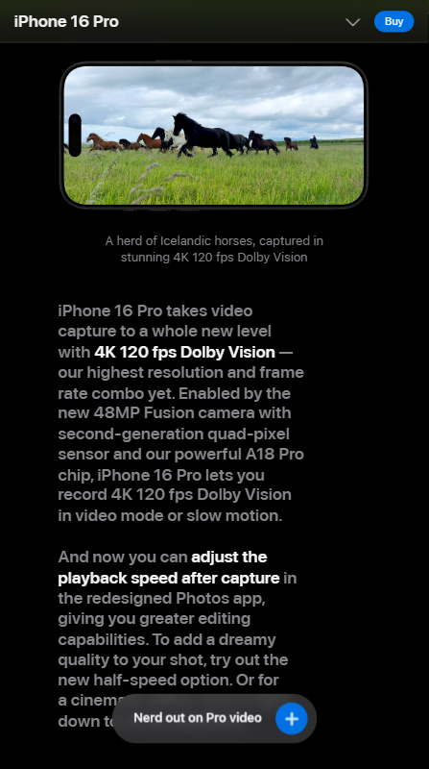
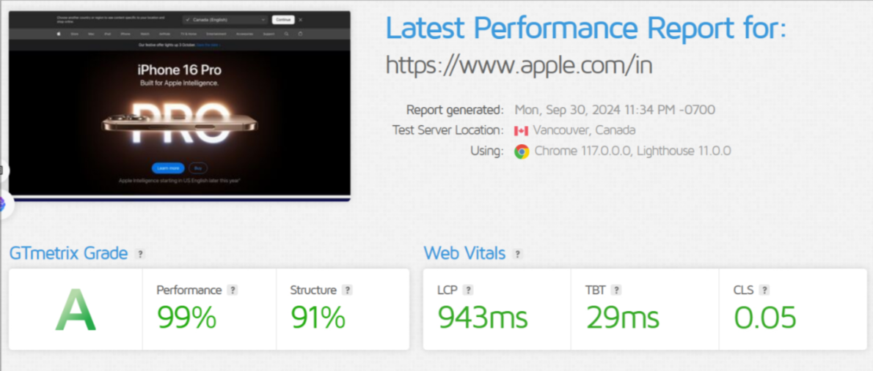
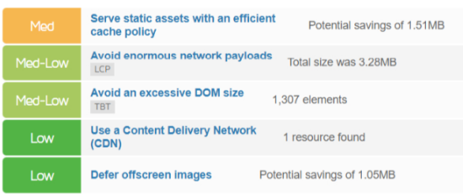

Slide 9
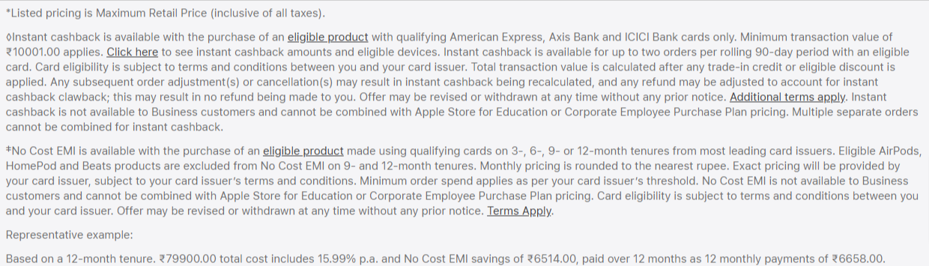
Suggestions to Apple.in Website:
Reduce the use of heavy images to improve load time.
Lots of heavy imagery and videos in the homepage without any information.( using Page speed Insights website )
Only new updates of apple products are shown in the homepage
price listing for cashback is at the bottom near terms and condition
Website Mistakes Identification

Slide 10
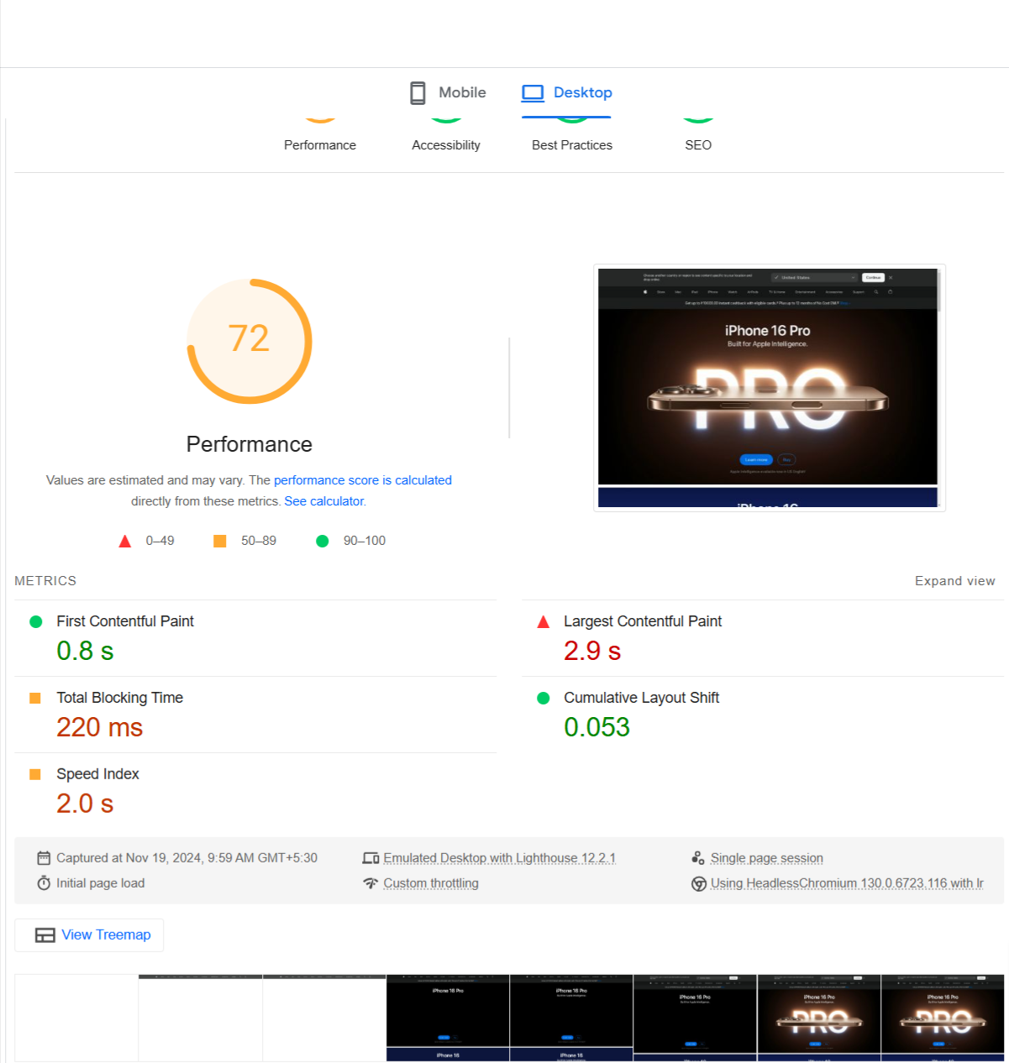
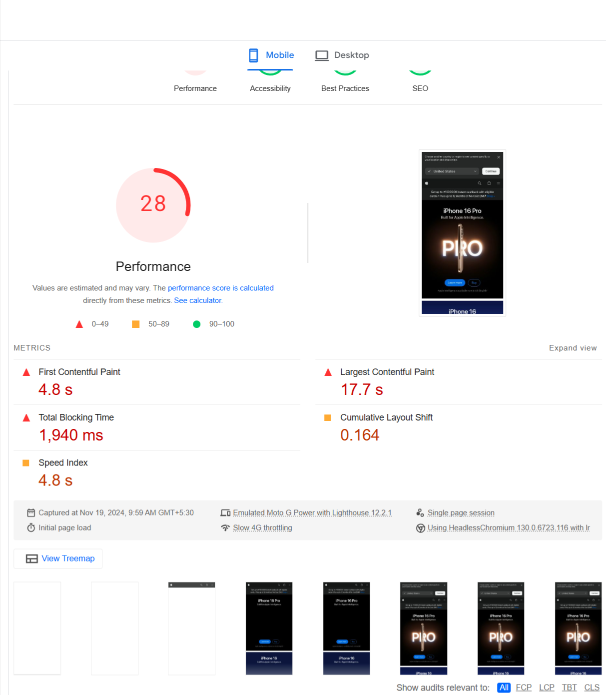

Slide 11
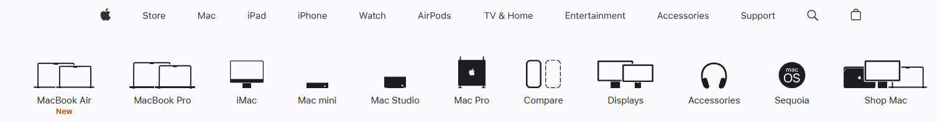
Suggestions to Apple.in Website:
Clear navigation button
They have dedicated page each of their product and applications
Maintain consistent branding throughout the site
Use clear and compelling call-to-action buttons in each page .
Website Best Practices List

Slide 12
Objective: Brand Awareness and Product Awareness
Design Features:
All Product Introduction in homepage
Strong and visible call-to-action to drive conversions
Dedicated space for each type of product instead of newly launched product
Link : https://www.figma.com/design/0sg4KOEoDvA6O2l5e8RnIO/Website-Wireframes-UI-Kit-(Community)?node-id=1-470&node-type=canvas&t=IAFwoOVUZ96NR2uf-0
https://github.com/balamurali2103/Guvi-projects/blob/main/Apple_Menu%20(1).png
Landing Page Design

Slide 13
What I learned:
To use digital tools to understand the website
Understanding the fundamentals of website creation, identifying key design principles, and applying best practices to top search ranking
Crafted the landing page for product awareness
Conclusion

Slide 14
Thank You

